Slide 1



ARTIFICIAL INTELLIGENCE (AI)
Mini Project
Dataset: FruitVision

Slide 2
Group Members 1.Najmul Haque Majumder ID:2022-2-60-059 2.Ahnaf Tahmid Chowdhury ID:2021-1-60-086 3.Jarin Tasnim Maowa ID:2021-2-50-009 4.Md Ashraful Islam ID:2021-1-60-009

Slide 3
Objective
Enable accurate classification of fruits into fresh, rotten, and formalin-mixed categories.
Support automation in food inspection processes, reducing reliance on inefficient manual evaluation.
Assist researchers in computer vision, agriculture, and food safety to develop models for real-time fruit quality monitoring.
Contribute to improvements in public health, agricultural productivity, and export quality control by detecting spoilage or contamination.

Slide 4
Introduction
Evolution of Image Classification in Computer Vision
Traditional ML methods used handcrafted features (SIFT, SURF, HOG), requiring domain expertise and lacking generalizability
Deep learning, especially Convolutional Neural Networks (CNNs), transformed image recognition.
CNNs automatically learn hierarchical features from raw data, eliminating the need for manual feature engineering.

Slide 5
Dataset Details
Initial size: 10,154 images (5 fruits – apple, banana, mango, orange, grapes)
Expanded: 81,000+ images via augmentation (rotation, scaling, brightness)
Categories: Fresh, Rotten, Formalin-mixed
Applications:
1.Real-time fruit quality assessment
2.Contamination detection
3.Automated food inspection
Impact:
1.Public health & food safety
2.Export quality control
3.Agricultural productivity

Slide 6
Model Architectures
Baseline Custom CNN
The baseline CNN is our custom-built architecture with three convolutional blocks ( Conv→BatchNorm→ReLU→MaxPool ) followed by fully connected layers and dropout for regularization. It serves as the foundation for comparison
 | filters | kernel | padding | MaxPool
Conv1 | 3 | 3 | 1 | 2x2
Conv2 | 32 | 3 | 1 | 2x2
Conv3 | 64 | 3 | 1 | 2x2
FC1: 128×28×28
→ 512 + ReLU + Dropout(0.5)
FC2: 512

Slide 7
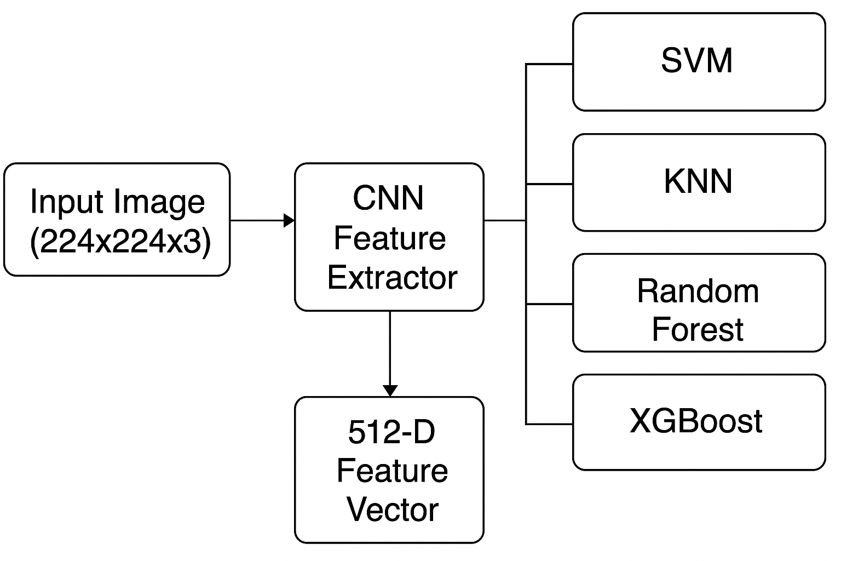
Model Architectures
CNN Model with ML Classifiers
We extracted 512-dimensional features from the CNN (using the extract_features method).These features were then fed into traditional ML classifiers to evaluate whether they improve over end-to-end CNN training.
We experimented with:
SVM (RBF kernel)
KNN (k=5)
Random Forest (200 trees)
XGBoost (gradient boosting)

Slide 8
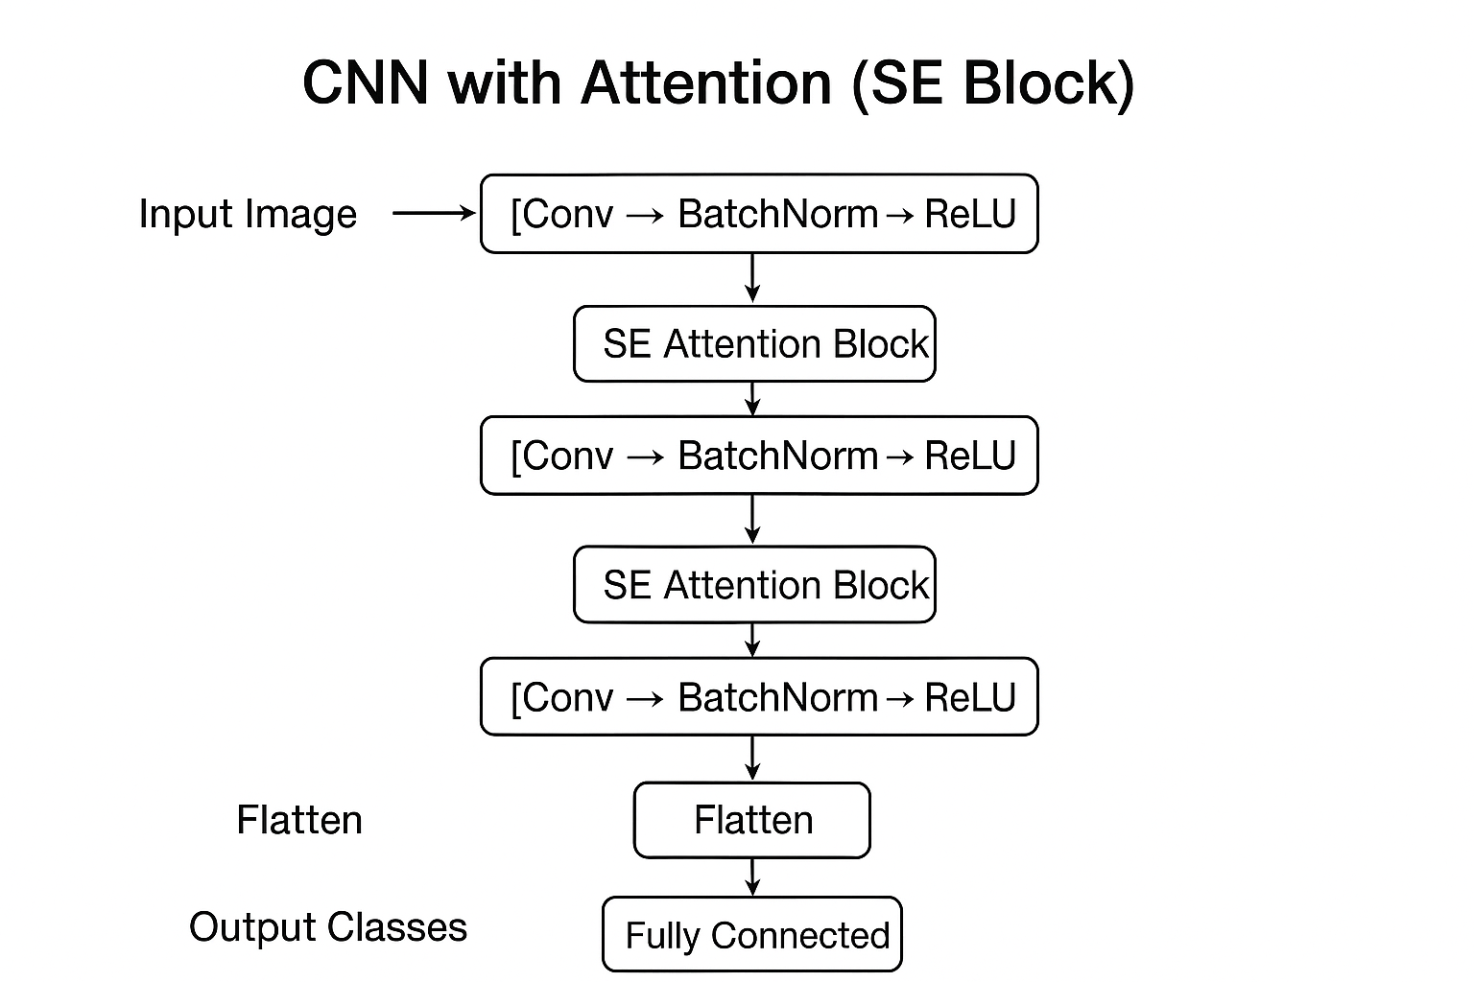
Model Architectures(con)
CNN with Attention (SE Block)
We added SE attention blocks to our CNN, enabling the model to focus on important features like rotten spots on fruits, improving classification accuracy.
Added SE attention blocks to CNN
Helps focus on key features like fruit rotten spots
Improves classification accuracy

Slide 9
Model Architectures(con)
Pre-trained CNN
ResNet
Key Idea: Uses residual (skip) connections to allow very deep networks.
Strength: Solves vanishing gradient problem, high accuracy for deep models.
Accuracy: 96%
Googlenet
Key Idea: Uses Inception modules that apply multiple filter sizes in parallel.
Strength: Efficient, reduces computational cost while maintaining accuracy.
Accuracy:97%
Efficient-Net
Key Idea: Scales width, depth, and resolution of the network uniformly for better efficiency.
Strength: Achieves state-of-the-art accuracy with fewer parameters.
Accuracy:99%

Slide 10
Model Training Parameters
Input Setup
Image size =224 × 224 × 3
Batch size =32
Train/Validation/Test split ratio=70/15/15
Training Configuration
Number of epochs is 20
Optimizer =Adam
Learning rate is 0.0001
Regularization & Stability
Dropout rate (e.g., 0.5 in Custom CNN)
Batch Normalization (if used)
Checkpoint saving (best model stored)
Evaluation Metrics
Accuracy (Train & Validation)
Loss (Train & Validation)
Hardware / Training Environment
GPU/CPU used (CUDA if available)
Training time per model (minutes)

Slide 11
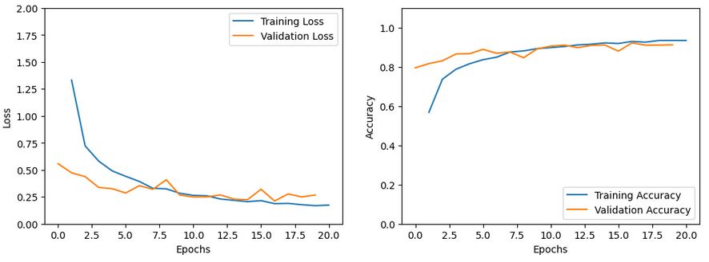
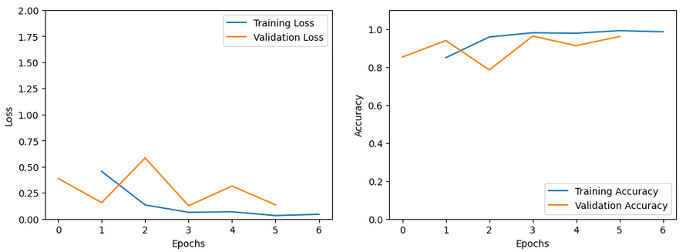
All Model Learning Curves
Custom CNN
loss decreases steadily.
reaching ~90–95% after 20 epochs.
low overfitting.
stable and learns effectively.
ResNet
faster than the custom CNN.
accuracy stabilize above 90%.
more efficient and achieves strong performance quickly.

Slide 12
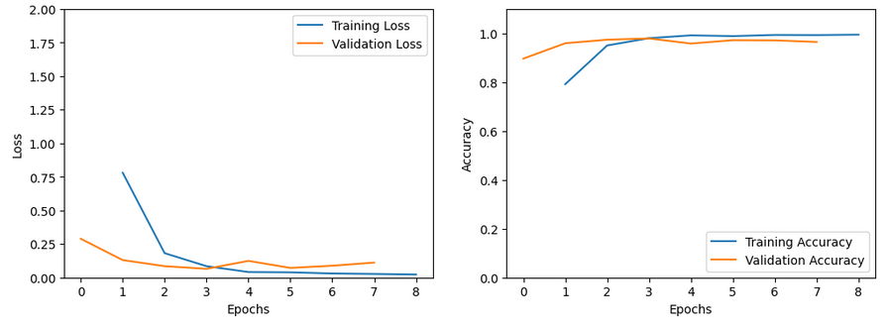
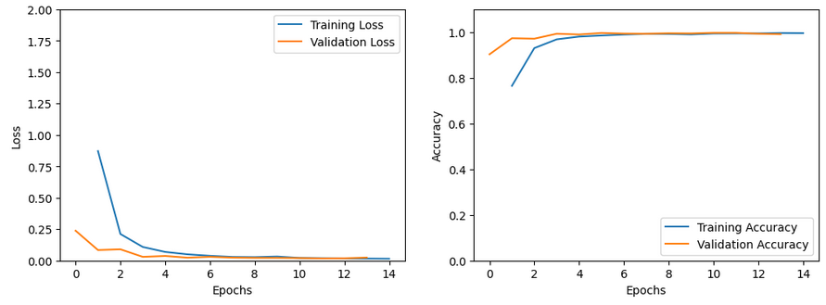
All Model Learning Curves
GoogleNet
loss drop sharply within first few epochs.
95–98% quickly (within 4–5 epochs).
Efficient in learning, but with more computation
EfficientNet
smoothly and consistently across epochs.
increases and reaches ~98–99%.
high generalization ability.
Performs best among tested models.

Slide 13
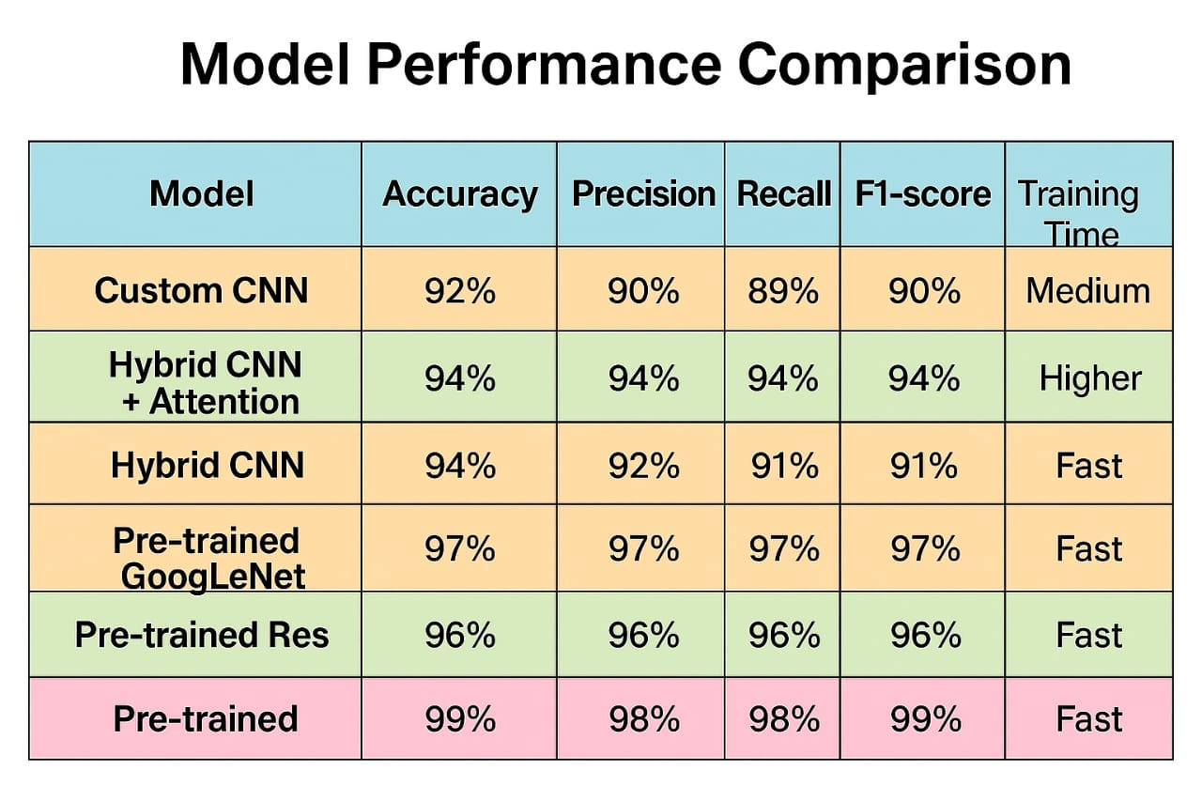
Table
Performance Comparison

Slide 14
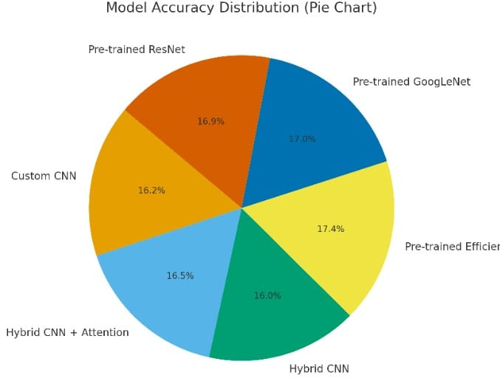
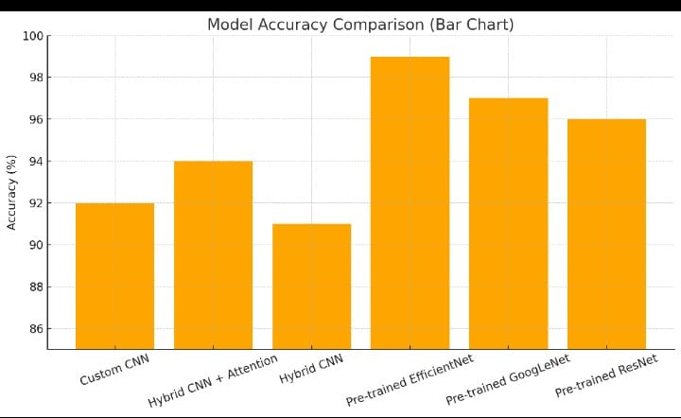
Bar & Pie diagram
Performance Comparison

Slide 15
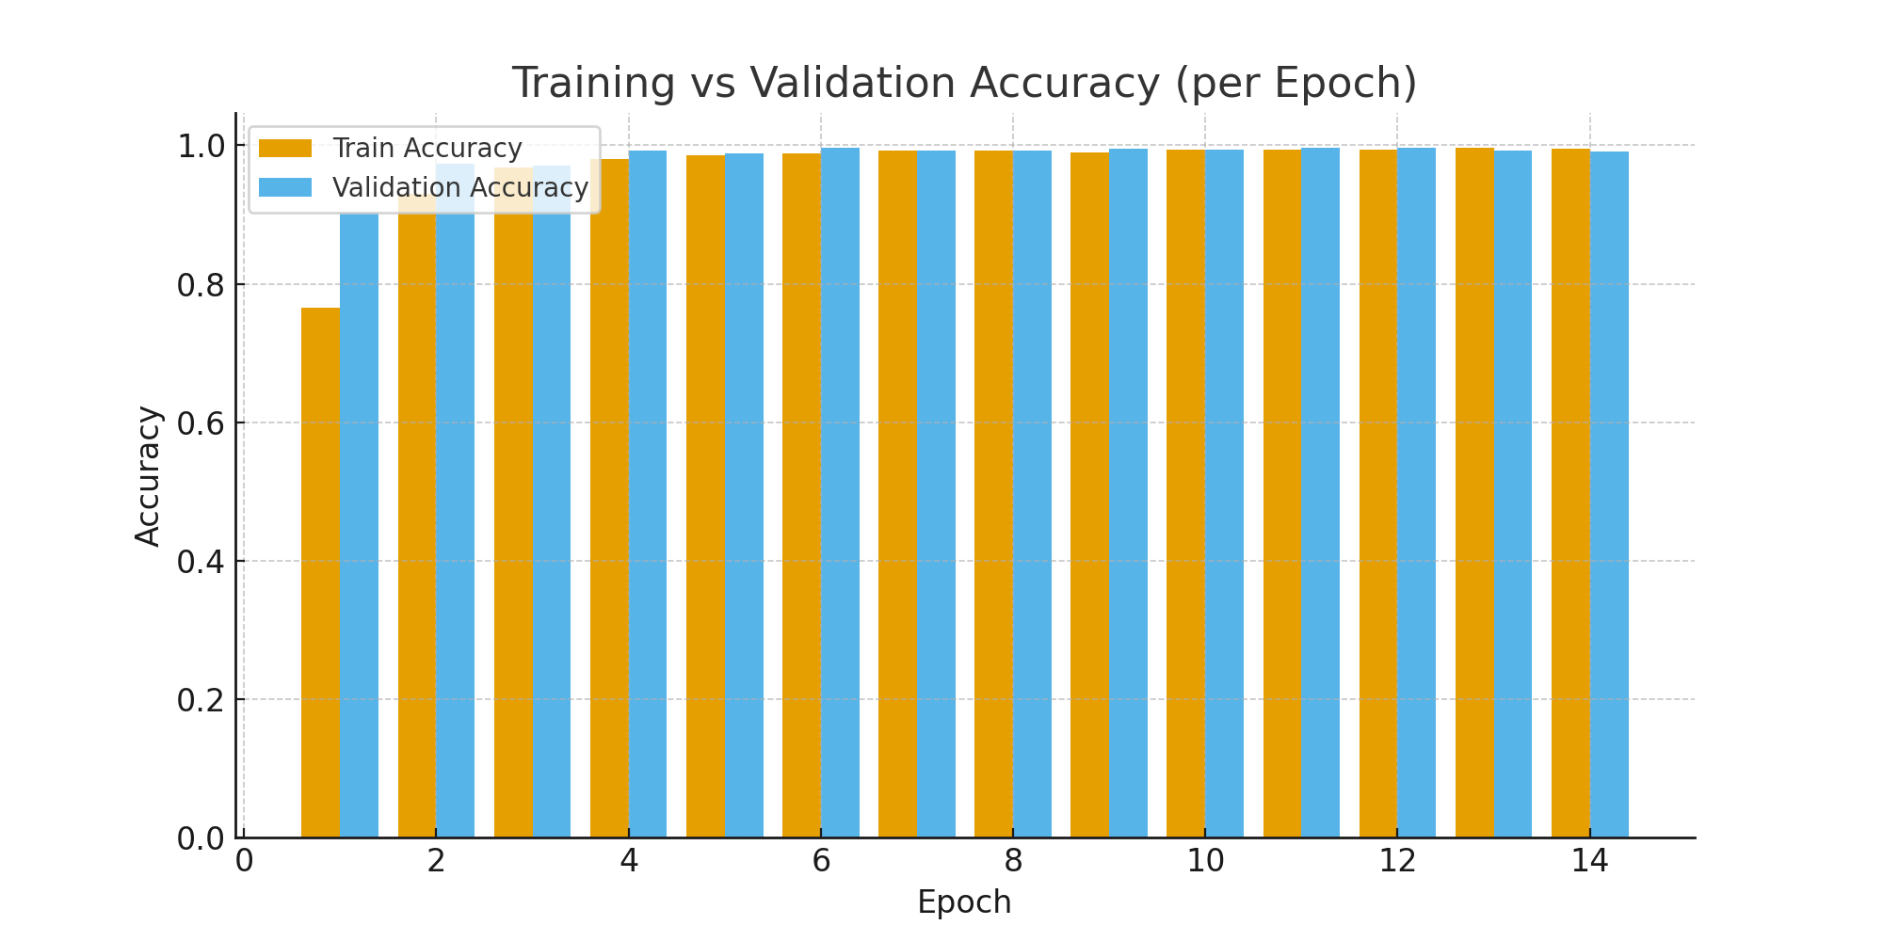
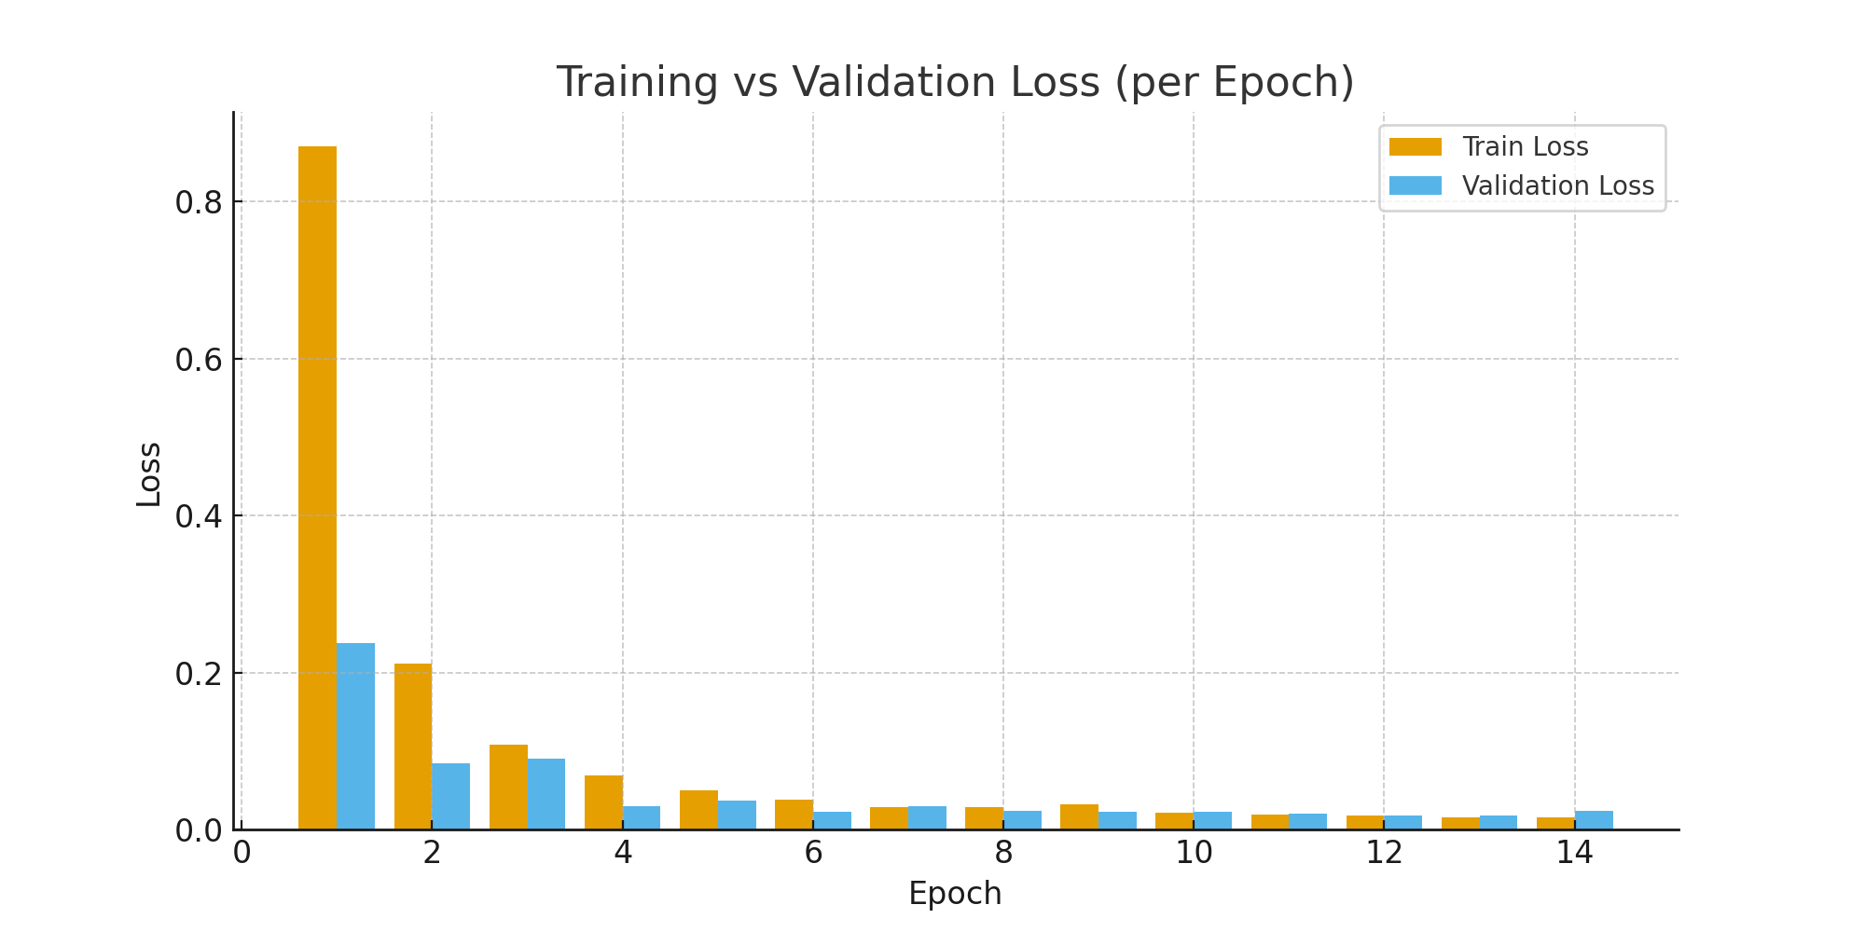
Best Model Finding(EfficientNet)
Training Loss dropped sharply from 0.87 → 0.02, showing strong learning progress.
Validation Loss also reduced from 0.23 → ~0.02, indicating good generalization.
Training Accuracy improved steadily from 76.5% → 99.6%.
Validation Accuracy increased from 90.3% → 99.7%, very close to training accuracy.
From epoch 4 onwards, both training and validation losses stabilized at very low values.

Slide 16
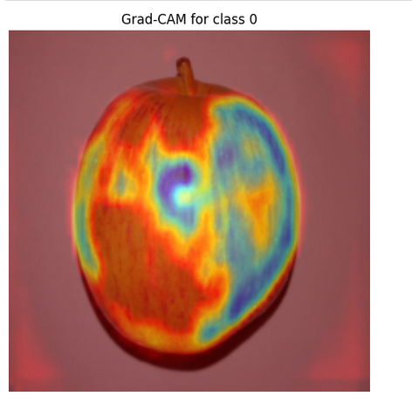
Grad-CAM Visualizations
Grad-CAM highlights the image regions most important for a CNN’s decision. In this code, forward hooks capture feature maps, backward hooks capture gradients, and their weighted combination produces a heatmap. This heatmap, when overlaid on the input image, shows where the model focused to classify the object.

Slide 17
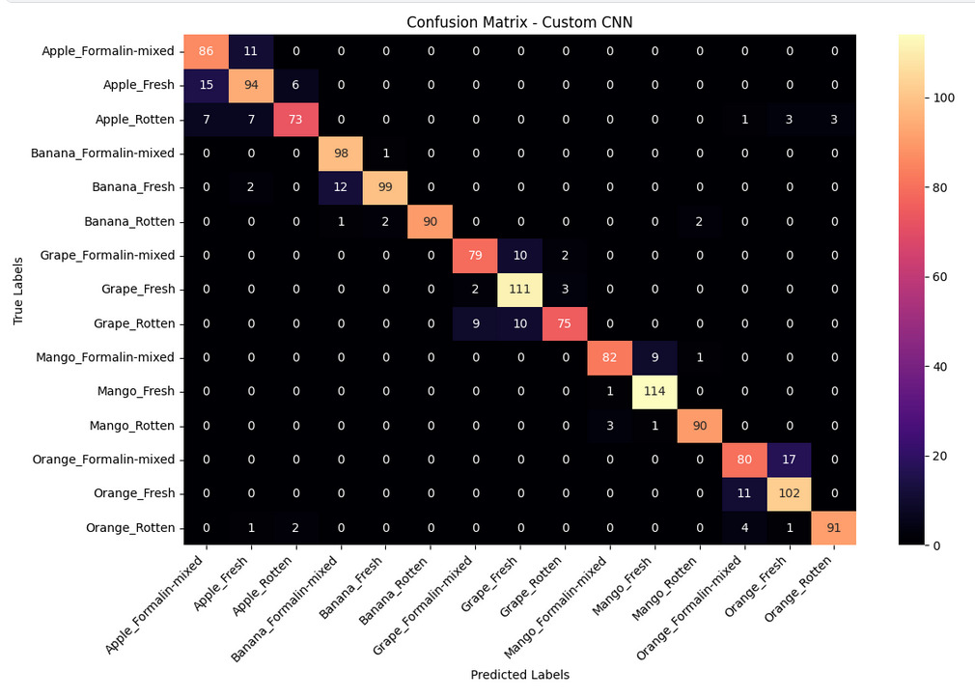
Confusion Matrix
High Accuracy: Most predictions correct (diagonal dominance).
Fresh Fruits: Very strong performance (esp. Mango_Fresh, Grape_Fresh, Banana_Fresh).
Misclassifications: Mostly within same fruit (Fresh ↔ Formalin-mixed ↔ Rotten).
Cross-fruit Errors: Very rare.
Improvement Needed: Reduce confusion between formalin-mixed vs. fresh/rotten.

Slide 18
Our project shows that a custom CNN can successfully detect and classify different fruits with good accuracy. Through proper data preprocessing, training, and evaluation, we demonstrated the effectiveness of deep learning in solving real-world image classification problems. This project also opens the door for future improvements with larger datasets and broader applications.
Conclusion

Slide 19
Contribution
01
02
03
Najmul Haque Majumder
25%
Md Ashraful Islam
25%
Ahnaf Tahmid
25%
04
Jarin Tasnim Maowa
25%

Slide 20


Thank You

